Slide 1
Automated Lip Reading
Instructor: Lee-Ad Gottlieb, Ph.D.
Team Members: Tal Noam, Evgeny Vendrov, Amitai Zamir.

Slide 2
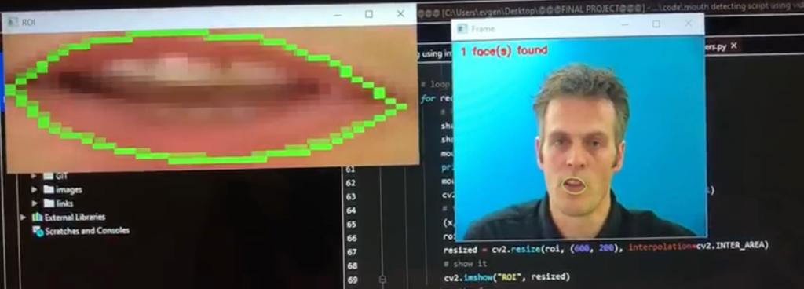
What Is Our Purpose?
Our goal is to develop a machine learning algorithm, based on DNN architecture, which will be “trained” to extract text out of a voice-less video of a speaking person, based on the movement of speakers lips.

Slide 3
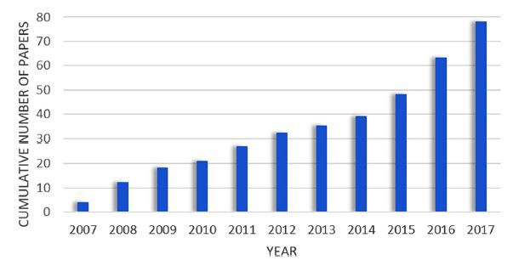
How Do We Know Its Even Possible?
Our first, intuitive, indication that learning how to read lips is possible – is the fact humans do it with great efficiency for centuries.
As we researched the topic, we found that with the advancing of Computer Vision and Deep Learning technologies – ALR Machine Learning based systems became more and more popular, this advancing in the DL field made the problem “solvable” as the deterministic algorithm approach yields bad results. We found that the cumulative number of papers on ALR systems published between 2007 and 2017, was growing rapidly, as seen below:

Slide 4
How Do We Know Its Even Possible? (cont.)
Out of many studies we found - two relatively recent once (‘16 and ‘17) achieve high accuracy on their datasets, and use DNN architectures – which we thought we could use to achieve efficiency.
We now have the proof that creating an ALR system using a DNN model is possible.

Slide 5
Studies We Base On
This first is “LIPNET: END-TO-END SENTENCE-LEVEL LIPREADING”(2016) by Yannis M. Assael, Brendan Shillingford, Shimon Whiteson & Nando de Freitas, from the Department of Computer Science, University of Oxford, Google DeepMind and CIFAR.
The Second is “Lip2AudSpec: Speech reconstruction from silent lip movements video”(2017) by Hassan Akbari, Himani Arora, Liangliang Cao and Nima Mesgarani from the department of Electrical Engineering, Columbia University. Please notice, that in this study, the problem they are solving is “bigger” then only reading lips, but we thought that the DNN architectures used for the ALR part can be used in our model.
Our project is based on these two studies.

Slide 6
Possible Uses Of ALR
The first thing comes to mind is using ALR systems to create various devices for the deaf population.
Another use can be transcribing videos with poor or no sound, i.e. converting videos to text, this can be used for many proposes as: “summing” a pre-filmed lecture, transcribing security camera footage with no sound – if this can be done in real time it can be used as part of intelligent security system.
We can even consider using ALR systems on intelligent robots as part of their communication system.
This field has endless optional use cases.

Slide 7
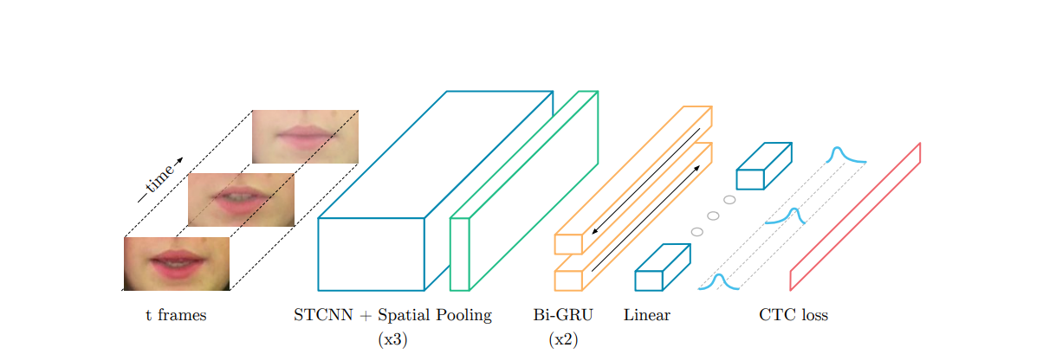
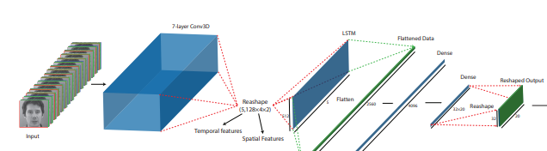
Architecture
“LIPNET” architecture:
“Lip2AudSpec” architecture: (only the relevant part)

Slide 8
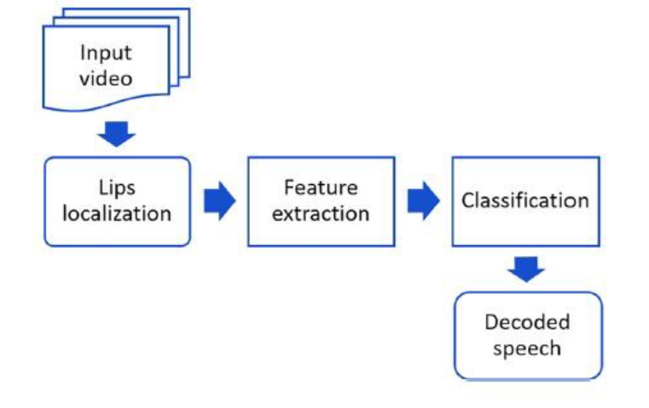
Architecture (cont.)
As we can see – both systems are built very similarly, the basic concept is using this kind of “pipeline”:
Input video is a data point from the data set – which has to contain a person speaking in front of the camera – and a matching text file of everything was said.
Lips localization can be done using already trained CNN from OpenCV library
Feature extraction from the already localized lips is done using a CNN – this one we have to train
Classification is done using some kind of RNN – we saw that “LIPNET“ used two layers of Bi-GRU while “Lip2AudSpec” used many layers of LSTM
Then – decoding the speech is done by flattening the output layer of the RNN and passing it through SoftMax output layer
Loss is calculated using CTC or Cross Entropy and is the difference between what the model predicted with the actual matching to the video text file

Slide 9
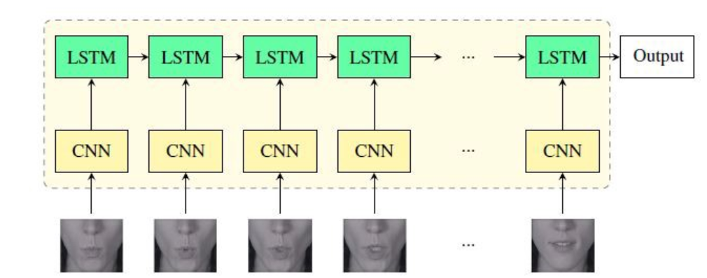
Architecture (cont.)
Assuming we got the “lips frame” from OpenCV – this is a basic look on the architecture

Slide 10
What Is Done – What Has To Be
We have collected a large and rich data set of “speaking heads” videos – with matching text files of what has been said.
We have succeed using OpenCV on the dataset videos to extract lips, and we already got the scripts to pre-process the data (i.e. extract lip frames every x seconds/frames)
We have succeed using AWS “SageMaker” and “S3” to run basic ML algorithm on its data set (only as a test)
Now, our next mission is preprocessing the data set on AWS (we deal with videos which makes it a hard computing mission – so it almost can’t be done on plain laptop)
Then we have to start training the model we described and adjusting it to the preform better.

